Slide 1
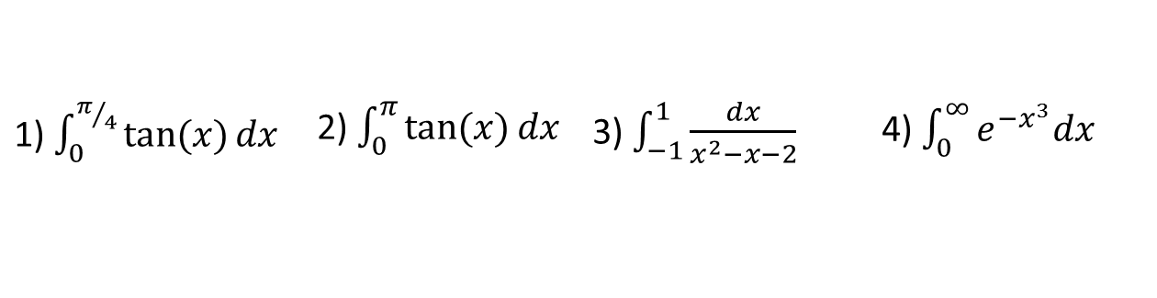

Review
Which of the following integrals are improper? Why?
State the type of improper integral and determine whether each integral is convergent or divergent. Evaluate those that are convergent.
1) $\int_{0}^{π/4}{\tan{(x)}dx}$ | 2) $\int_{0}^{π}{\tan{(x)}dx}$ | 3) $\int_{−1}^{1}{\frac{dx}{x^{2}−x−2}}$ | 4) $\int_{0}^{∞}{e^{{−x}^{3}}dx}$
5) $\int_{−∞}^{0}{\frac{1}{3−4x}dx}$ | 6) $\int_{2}^{∞}{\frac{dv}{v^{2}+2v−3}}$
Notes:
Proper
Infinite Discontinuity @ pi/2
Infinite Discontinuity @ -1
Infinite limit of integration
(7.8, #7) Type-I: infinite limit of integration, divergent (7.8, #7)
(7,8 #18) Type-I: infinite limit of integration (note (v-1)(v+3) = 0 @ v=1 & v=3…but outside limits of integration. = Ln(5)/4
Type-II: at x = 3. = 2
5
Ln(2)

Slide 2
Math 152 – Lesson 15
Lesson | Topic | Reading
14 | Improper Integrals | 7.8
15/16 | Work/Ave Value of a Function | 6.4/6.5
17/18 | Applications to Physics & Eng | 8.3
Objectives:
Compute work done by a constant force
Identify when an integral is required to calculate work
Develop & evaluate an integral to determine the work done by lifting an object
Develop & evaluate an integral to determine the work done by pumping liquids

Slide 3
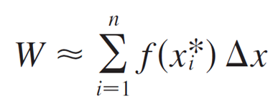
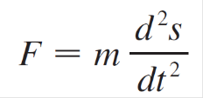
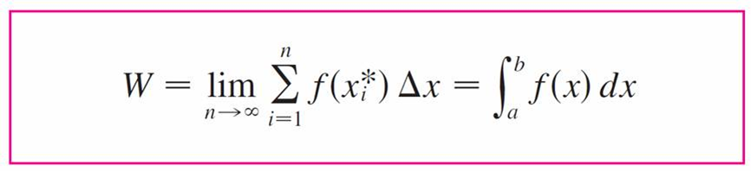



Work
$$Work=Force×Distance$$
$$Force=Mass×Acceleration$$
$$\int_{a}^{b}{F\left(x\right)dx}$$
Units | Mass | Force | Distance | Work
International (SI) (metric) | Kilograms (kg) | Newtons (N) | Meters (m) | Joules (J)
British | slug | Pound (lb) | Feet (ft) | Foot-pound (ft-lb)
Notes:
In space, a “50lb / 20kg” iron plate would “weigh” 0lb, but still be 20kg

Slide 4
Example 1
When a particle is located a distance x feet from the origin, a force of x² + 2x pounds acts on it. How much work is done in moving it from x = 1 to x = 3?
Solution:
The work done is 16 2/3 ft-lb.

Slide 5
Hooke’s Law
Hooke’s Law holds for small x
k is the spring const
(a) Natural position of spring
(b) Stretched position of spring
Hooke’s Law

Slide 6
Desk Work
A force of 40 N is required to hold a spring that has been stretched from its natural length of 10 cm to a length of 15 cm. How much work is done in stretching the spring from 15 cm to 18 cm?

Slide 7

Solution
Solution:
f(x) = kx = k*0.05 = 40 k = = 800
Thus f (x) = 800x and the work done in stretching the spring from 15 cm to 18 cm is
= 400[(0.08)² – 0.05)²]
= 1.56 J

Slide 8
Pulling
How much work is required to pull a rope hanging over a 50-foot building and touching the ground, weighing 0.1 pounds per foot, until the bottom of the rope is 20 feet off the ground?
Now, how much work is required if a 35 lb bucket is attached to the end of the rope?
Rope (weighs 0.1 lbs/ft)
Building (50 ft high)
Let h be the distance from the bottom of the rope to the ground
Notes:
XL 1: .1ft increments
XL2: .5 ft increments
Plot 1 = work per ft for XL .1ft increments. With and without 35# weight
Plot 2 = total work (the integral of W = FD)…note, one is linear, the second quadratic
Rope Length = (50 - h)(ft)
Rope Weight(Force) = (50 – h)(ft)(0.1#/m) = (5 – h/10)#
Work = F D. the TOTAL “D” = 20ft, made up of increments of “dh”
W = ʃ $(\text{5 – }\text{h}\text{/10)(\#)}\text{dh}\text{ = 5}\text{h}\text{ −}{ (h}^{2 })/20,evaluated from 0 to 20$ft
= [(5(20) - ${ (20}^{2 })/20) −(0)]=100 −20=80ft lb$
////////
Add the 35lb bucket.
Either add W = FD = 35#(20ft) = 700 $ft lb$
OR, included it in the integral
Weight(Force) = (50 – h)(ft)(0.1#/ft) = (5 – h/10)# + 35# = 40 – h/10
W = ʃ $(\text{40}\text{ – }\text{h}\text{/10)(\#)}\text{dh}\text{ = 40}\text{h}\text{ −}{ (h}^{2 })/20,evaluated from 0 to 20$ft
= [(40(20) - ${ (20}^{2 })/20) −(0)]=800 −20=780ft lb$
//////
700 $ft lb$ + $80ft lb$ = $780ft lb$

Slide 9

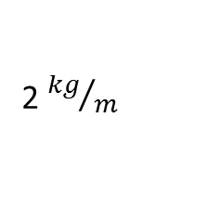
Desk Work - Pulling
Find the work required
to lift the sandbag to a
height of 50 m
2. Find the work required
to lift the sandbag 50 m
assuming it is leaking
1 kg of sand for each
meter it is lifted
2 ${kg}/m$
100 m
500 kg
Notes:
1) Rope Length = (100 - h)(m)
Rope mass = (100 – h)(m)(2kg/m) = (200 – 2h)kg
Sandbag mass = 500kg
Total MASS = (700 – 2h)kg
Total FORCE = (700 – 2h)kg(9.8m/s s) = 9.8(700 – 2h)N
Work = F D. the TOTAL “D” = 50m, made up of increments of “dh”
W = 9.8ʃ $(\text{700 – 2}\text{h}\text{)}\text{dh}\text{ = 700}\text{h}\text{ −}{ (h}^{2 }),evaluated from 0 to 50m$
= 9.8[(700(50) - ${ (50}^{2 })) −(0)]=9.8[35000 −2500]=9.8(32500)=318500 N m$
2) Rope Length = (100 - h)(m)
Rope mass = (100 – h)(m)(2kg/m) = (200 – 2h)kg
Sandbag mass = (500 – 1h)kg
Total MASS = (700 – 3h)kg
Total FORCE = (700 – 3h)kg(9.8m/s s) = 9.8(700 – 3h)N
Work = F D. The TOTAL “D” = 50m, made up of increments of “dh”
W = 9.8ʃ $(\text{700 – 3}\text{h}\text{)}\text{dh}\text{ = 700}\text{h}\text{ −}{ (\frac{3}{2})(h}^{2 }),evaluated from 0 to 50m$
= 9.8[(700(50) - ${ (\frac{3}{2})(50}^{2 })) −(0)]=9.8[35000 −3750]=9.8(31250)=306250 N m$

Slide 10
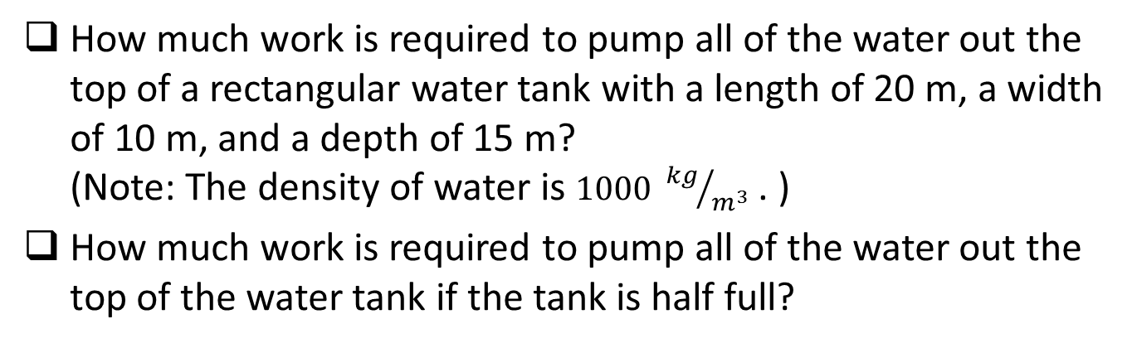
Pumping
How much work is required to pump all of the water out the top of a rectangular water tank with a length of 20 m, a width of 10 m, and a depth of 15 m? (Note: The density of water is $1000 {kg}/{m^{3}}$ . )
How much work is required to pump all of the water out the top of the water tank if the tank is half full?
Slice of water
15 m
Distance slice moves
10 m
20 m
Notes:
Mass of layer of water: m = (10)(20)(dh)(1000) (kg)
Force required to lift that water: F = m a = 2e5(9.81 m / s s)
W = F D, H = Distance to the top
1) W = ʃ [2e5(9.81 m / s s) H dh, from 0 to 15
2) From 7.5 to 15

Slide 12
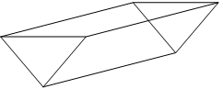
Board Work
A 200 lb cable is 100 ft long and hangs vertically from the top of a tall building. How much work is required to lift the cable to the top of the building?
A construction worker standing on a roof 30 ft off the ground pulls a 1000-lb weight to a height 10 ft off the ground using a rope which weighs 4 lb/ft. Find the work done to lift the weight.
An upright cylindrical ketchup container at a restaurant (which is half full) has a radius of 5 inches and a height of 11 inches. Given that the ketchup weighs 0.38 lb per cubic inch, how much work is required (in ft-lb) to pump the ketchup out of the nozzle (which is 3 inches above the top of the container?
The water trough below is 2 m tall, 2 m wide, and 4 m long. How much work is required to pump all of the water out of the top of the trough if the depth of the water is 70 cm? Note: The density of water is 1025 kg/m3.

Slide 13
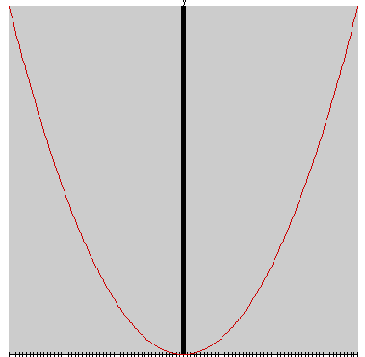
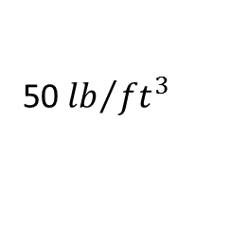

Work - Pumping
How much work is
required to pump
the fuel out of the
lower nozzle?
2. How much work is
required to pump
the fuel out of the
upper nozzle?
10 ft
100 ft
50 ft
$${ h}^{2 }$$
50 ${lb}/{{ft}^{3}}$
h

